Slide 1

Pawmark
Server setup

Slide 2
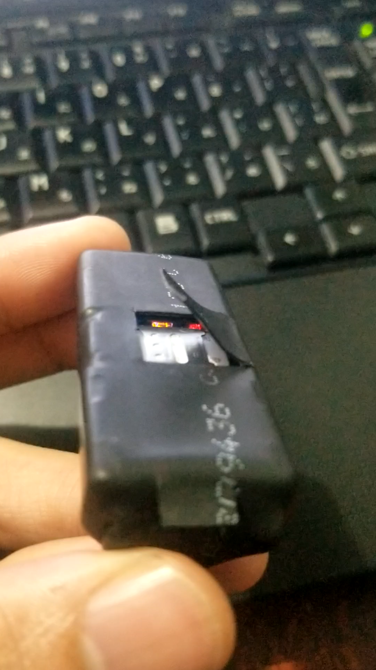
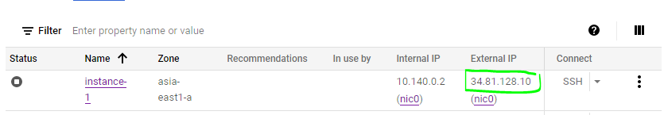
Collar Device
Note: The device won’t right away, it should first be configured to (1)enable internet access and also (2)needed to point it to the correct server address. 1.To enable internet access, use your mobile phone and sent an SMS to the SIM card you will be using, type in : APN#internet#
You should receive a reply that says : OK
2. To point it to the right server ip address, obtain the ip from your server, then you should send an SMS to the sim you choose, type in : DOMAIN#34.81.128.10#5023#
1
A SIM Card that has mobile data should be inserted
Red Light – Battery Level LED, fast blinking low battery, slow blinking is normal. Yellow - GSM Signal LED, bright error, fast blinking search network, slow blinking connected to network Blue – GPS signal LED, fast blinking search GPS satellite, slow blinking connected to GPS satellite
2

Slide 3
Using Google Cloud Compute Engine
Google cloud compute engine is necessary to run our linux server 24/7
It is a paid service (cost are computed per hour)

Slide 4
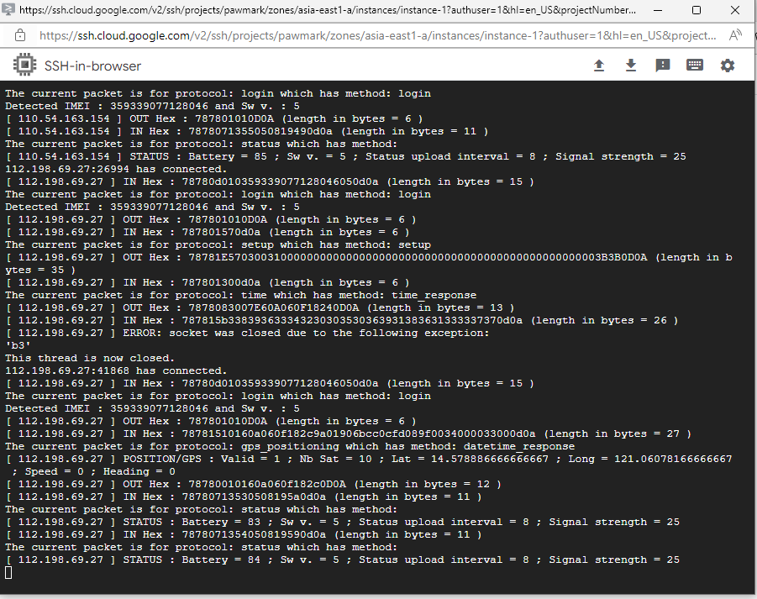
Cent OS in Google Cloud Compute Engine
How it works:
1
Cent OS is up and running 24/7
2
It contains our Python source code, which runs in the background
3
Using python built in socket, it continuously listening for connections from collar devices.
4
Once a device is connected, it is also responsible in saving the current location sent by the device

Slide 5
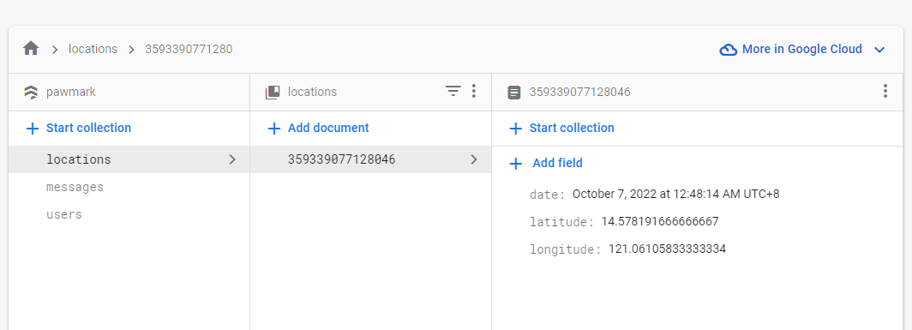

Firebase Database
This is the structure of the table ”location”:
2
Location information are updated continuously as long as the device is still able to sent packets to the server.
1
Device unique number is used as a primary key

Slide 6








Flow Chart
Collar Device
Server
Database
Mobile App
Web App

